Slide 1
Immunology
By
Dr. Nelson Xess
Department of Microbiology
Bhanupratap Deo Govt. P.G College, Kanker, Chhattisgarh

Slide 2
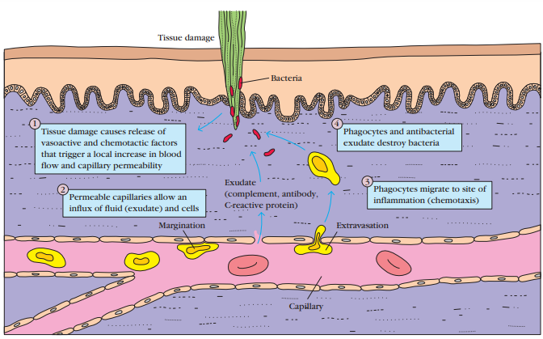
Major events in the inflammatory response. A bacterial infection causes tissue damage with release of various vasoactive and chemotactic factors. These factors induce increased blood flow to the area, increased capillary permeability, and an influx of white blood cells, including phagocytes and lymphocytes, from the blood into the tissues. The serum proteins contained in the exudate have antibacterial properties, and the phagocytes begin to engulf the bacteria

Slide 3
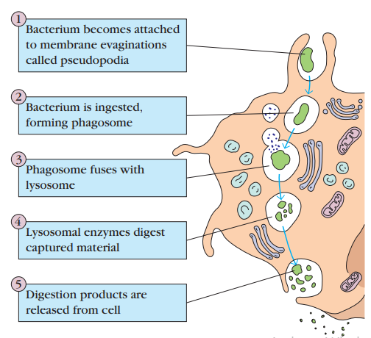
Phagocytosis

Slide 4
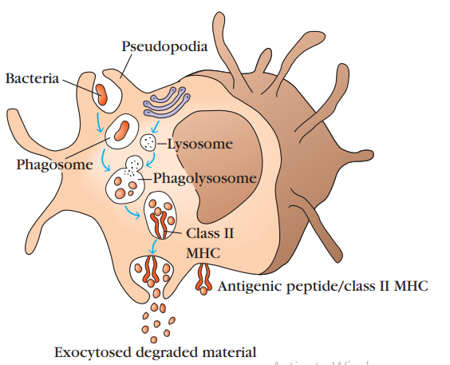

Slide 5
Hematopoiesis
All blood cells arise from a type of cell called the hematopoietic stem cell (HSC). Stem cells are cells that can differentiate into other cell types.
They are self-renewing they maintain their population level by cell division. In humans, hematopoiesis, the formation and development of red and white blood cells, begins in the embryonic yolk sac during the first weeks of development. Here, yolk-sac stem cells differentiate into primitive erythroid cells that contain embryonic hemoglobin. In the third month of gestation, hematopoietic stem cells migrate from the yolk sac to the fetal liver and then to the spleen; these two organs have major roles in hematopoiesis from the third to the seventh months of gestation.

Slide 6
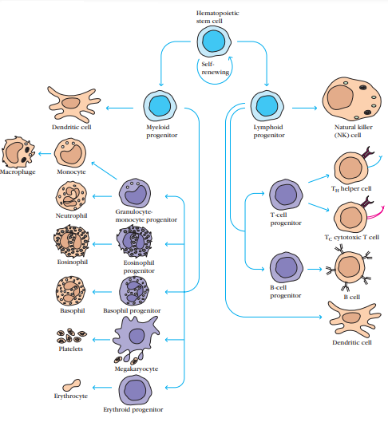

Slide 7
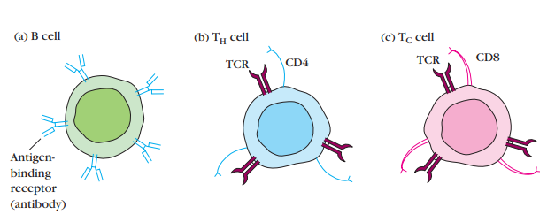
Distinctive membrane molecules on lymphocytes.
(a) B cells have about 105 molecules of membrane-bound antibody per cell. All the antibody molecules on a given B cell have the same antigenic specificity and can interact directly with antigen.
(b) T cells bearing CD4 (CD4+ cells) recognize only antigen bound to class II MHC molecules.
(c) T cells bearing CD8 (CD8+ cells) recognize only antigen associated with class I MHC molecules. In general, CD4+ cells act as helper cells and CD8+ cells act as cytotoxic cells. Both types of T cells express about 105 identical molecules of the antigenbinding T-cell receptor (TCR) per cell, all with the same antigenic specificity.

Slide 8
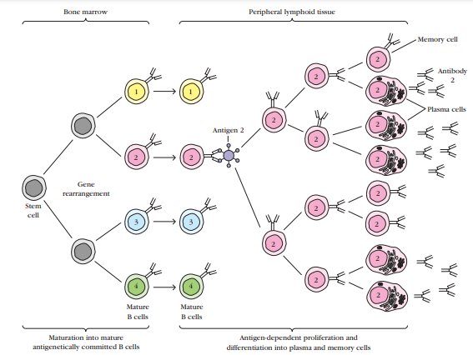
In this process of clonal selection, an antigen binds to a particular T or B cell and stimulates it to divide repeatedly into a clone of cells with the same antigenic specificity as the original parent cell

Slide 9
Maturation and clonal selection of B lymphocytes. Maturation, which occurs in the absence of antigen, produces antigenically committed B cells, each of which expresses antibody with a single antigenic specificity (indicated by 1, 2, 3, and 4). Clonal selection occurs when an antigen binds to a B cell whose membranebound antibody molecules are specific for epitopes on that antigen. Clonal expansion of an antigen-activated B cell (number 2 in this ex ample) leads to a clone of memory B cells and effector B cells, called plasma cells; all cells in the expanded clone are specific for the original antigen. The plasma cells secrete antibody reactive with the activating antigen. Similar processes take place in the T-lymphocyte population, resulting in clones of memory T cells and effector T cells; the latter include activated TH cells, which secrete cytokines, and cytotoxic T lymphocytes (CTLs).

Slide 10
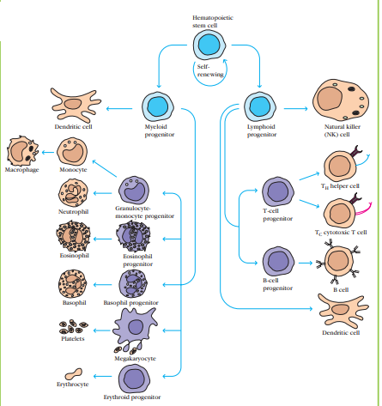
Hematopoiesis

Slide 11
Hematopoiesis
Hematopoiesis Self-renewing hematopoietic stem cells give rise to lymphoid and myeloid progenitors. All lymphoid cells descend from lymphoid progenitor cells and all cells of the myeloid lineage arise from myeloid progenitors. Note that some dendritic cells come from lymphoid progenitors, others from myeloid precursors.

Slide 12
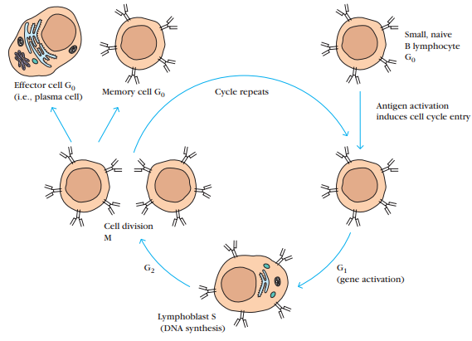
A small resting (naive or unprimed) lymphocyte resides in the G0 phase of the cell cycle. At this stage, B and T lymphocytes cannot be distinguished morphologically. After antigen activation, a B or T cell enters the cell cycle and enlarges into a lymphoblast, which undergoes several rounds of cell division and, eventually, generates effector cells and memory cells. Shown here are cells of the B-cell lineage
Cells of the Immune System

Slide 13
Primary Lymphoid Organs
Immature lymphocytes generated in hematopoiesis mature and become committed to a particular antigenic specificity within the primary lymphoid organs.
Only after a lympho cyte has matured within a primary lymphoid organ is the cell immunocompetent (capable of mounting an immune response). T cells arise in the thymus, and in many mammals—humans and mice for example—B cells originate in bone marrow

Slide 14
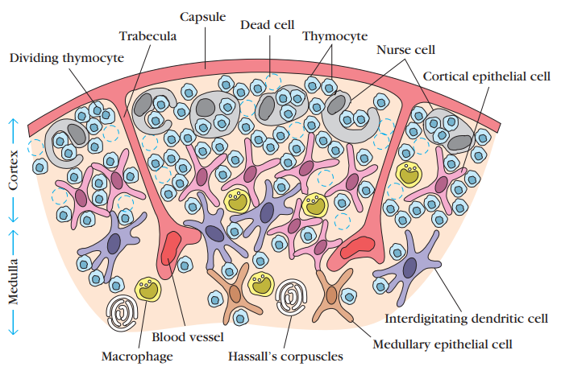
THYMUS
The thymus is the site of T-cell development and maturation. It is a flat, bilobed organ situated above the heart. Each lobe is surrounded by a capsule and is divided into lobules, which are separated from each other by strands of connective tissue called trabeculae. Each lobule is organized into two compartments: the outer compartment, or cortex, is densely packed with immature T cells, called thymocytes, whereas the inner compartment, or medulla, is sparsely populated with thymocytes.

Slide 15
Bone marrow
In humans and mice, bone marrow is the site of B-cell origin and development. Arising from lymphoid progenitors, immature B cells proliferate and differentiate within the bone marrow, and stromal cells within the bone marrow interact directly with the B cells and secrete various cytokines that are required for development. Like thymic selection during Tcell maturation, a selection process within the bone marrow eliminates B cells with self-reactive antibody receptors. Bone marrow is not the site of B-cell development in all species. In birds, a lymphoid organ called the bursa of Fabricius, a lymphoid tissue associated with the gut, is the primary site of B-cell maturation. In mammals such as primates and rodents, there is no bursa and no single counterpart to it as a primary lymphoid organ. In cattle and sheep, the primary lymphoid tissue hosting the maturation, proliferation, and diversification of B cells early in gestation is the fetal spleen.

Slide 16
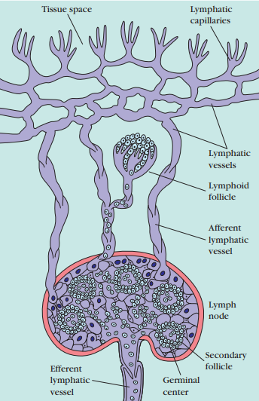
Lymphatic System
Lymphatic vessels. Small lymphatic capillaries opening into the tissue spaces pick up interstitial tissue fluid and carry it into progressively larger lymphatic vessels, which carry the fluid, now called lymph, into regional lymph nodes. As lymph leaves the nodes, it is carried through larger efferent lymphatic vessels, which eventually drain into the circulatory system at the thoracic duct or right lymph duct

Slide 17
Secondary Lymphoid Organs
Various types of organized lymphoid tissues are located along the vessels of the lymphatic system. Some lymphoid tissue in the lung and lamina propria of the intestinal wall consists of diffuse collections of lymphocytes and macrophages. Other lymphoid tissue is organized into structures called lymphoid follicles, which consist of aggregates of lymphoid and nonlymphoid cells surrounded by a network of draining lymphatic capillaries. Until it is activated by antigen, a lymphoid follicle—called a primary follicle—comprises a network of follicular dendritic cells and small resting B cells. After an antigenic challenge, a primary follicle becomes a larger secondary follicle—a ring of concentrically packed B lymphocytes surrounding a center (the germinal center) in which one finds a focus of proliferating B lymphocytes and an area that contains nondividing B cells, and some helper T cells interspersed with macrophages and follicular dendritic cells.
Lymph nodes and the spleen are the most highly organized of the secondary lymphoid organs; they comprise not only lymphoid follicles, but additional distinct regions of Tcell and B-cell activity, and they are surrounded by a fibrous capsule. Less-organized lymphoid tissue, collectively called mucosal-associated lymphoid tissue (MALT), is found in various body sites

Slide 18
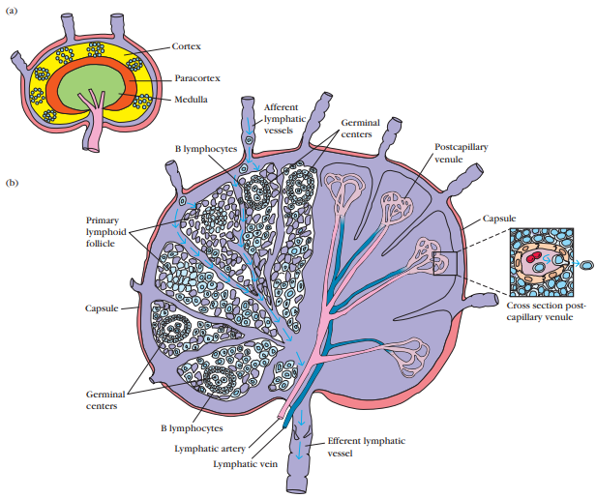
LYMPH NODES

Slide 19
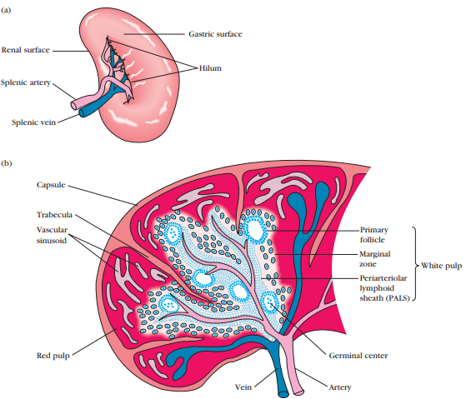
SPLEEN

Slide 20
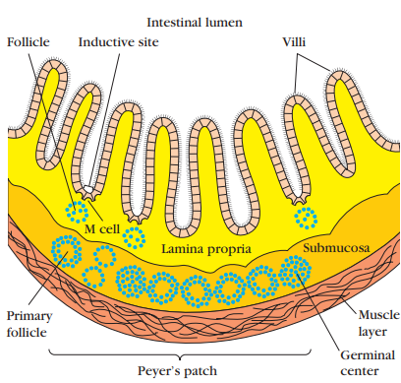

Slide 21
IMMUNOGLOBULINS
Immunoglobulins are glycoproteins secreted by plasma cells that recognise a particular epitopes in antigen binds specifically to it and facilitates its clearance.
Immunoglobulins consititute 20-25% of total serum proteins.
There are 5 classes of immunoglobulins IgG, IgA, IgM, IgD, IgE

Slide 22
Structure of immunoglobulins
Immunoglobulins are the antibodies which are produced by the plasma B-cells. These are glycoproteins which are highly specific to antigens. They have a 'Y' shaped structure. It consists of four polypeptide chains, two heavy (H) chains and two light (L) chains. The four polypeptide chains are held together by disulphide bonds to form a 'Y' shaped structure. The region holding arms and stem of antibody is termed as a hinge. Each chain of the antibody includes two distinct regions, the variable region and the constant region. Variable regions constitute the antigen-binding site (paratope). This part of antibody recognises and binds to the specific antigen forming an antigen-antibody complex. There are different type of immunoglobulins on the basis of the heavy chain as IgA (alpha chain), IgD (delta chain), IgE (epsilon chain), IgG (gamma chain) and IgM (mu chain). IgG and IgM are the most abundantly found.

Slide 23
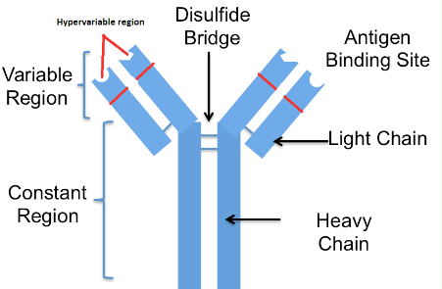

Slide 24
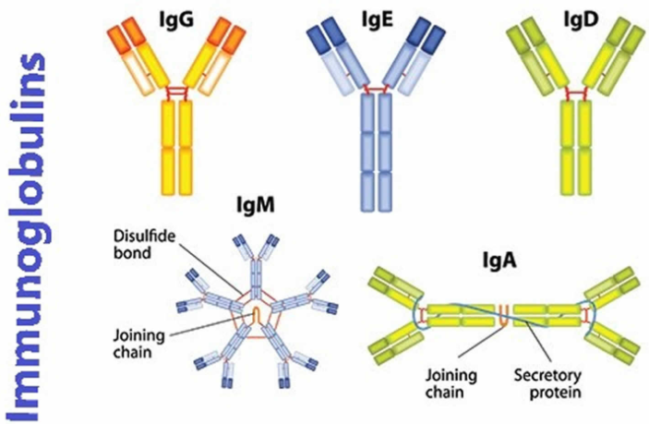

Slide 25
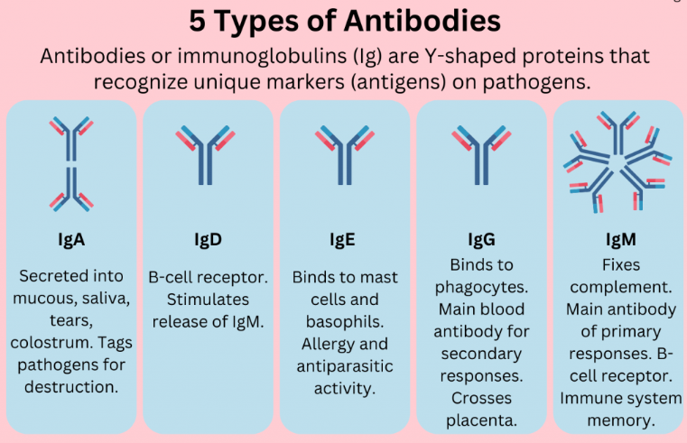

Slide 26
